Slide 1
Fake Review Detection on Yelp Dataset
Presented by Group 12

Slide 2
What is the Question ?
Identify Fake reviews in the Yelp Data set for NYC.

Slide 3


Dataset Description
Source: Acquired originally by Rayana and Akoglu for their research and shared to us on request.
Format: TSV
Description: Multiple files having information about Review text, Products, Users, and labels of true or false reviews.
Size: 358,957 records

Slide 4
More About Data
No. of Products: 923
No. of Users: 160201
Time period: 1st Jan, 2007 - 9th Sep, 2014
No. of Labelled Fake Reviews: 36860 (approx. 10% of overall)
No. of Labelled True Reviews: 322097 (approx. 90% of overall)

Slide 5
Literature Review (Most Relevant)
Fake Review Detection on Yelp by Zehui Wang (wzehui), Yuzhu Zhang (arielzyz), Tianpei Qian (tianpei).
Applied various models using linguistic and behavioral characteristics.
Good accuracy on Neural Networks.
Deceptive review detection using labeled and unlabeled data by Jitendra Kumar Rout, Smriti Singh, Sanjay Kumar, Jena Sambit Bakshi.
Text Categorisation (N gram).
Sentiment Score
What Yelp Fake Review Filter Might Be Doing? by Arjun Mukherjee, Vivek Venkataraman, Bing Liu, Natalie Glance
Comparison of Amazon Mechanical Turk (AMT) fake reviews with Yelp Data set.
Usage of Text as well as Behavior characteristics for identification.

Slide 6
Data Preprocessing
Merging datasets
Checking missing values
Checking duplicate rows
Text Processing
Removing Stopwords, Punctuation, Special characters
Lowercase the review text
Identifying common words in true and false reviews and removing them
Stemming - reducing inflection in words to their root forms

Slide 7
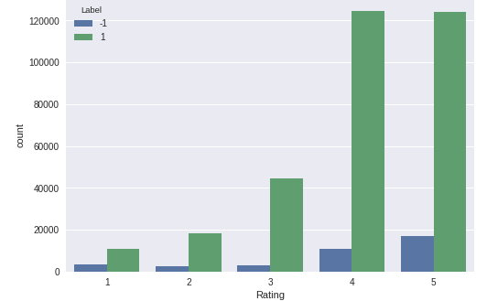
Exploratory Data Analysis
Comparing the number of reviews with rating for True and False.
Most fake reviews are having 4 or 5 rating, therefore fake reviews are generally positive.
Marketing strategy ?
Maybe ?

Slide 8
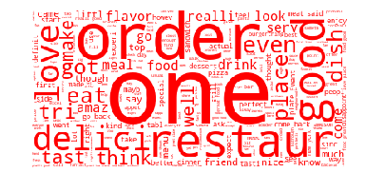
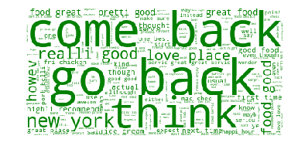
Word Cloud of Words in reviews
False Reviews True Reviews

Slide 9
Behavioral Features Extracted
Behavioral analysis of the user’s review pattern
Average user rating
Total reviews given by user
How the restaurant performed in general
Average restaurant rating

Slide 10
Text Features Extracted
Extracted Text features from Review text.
Features Added -
Sentiment Score
Number of Nouns
Review Length
Number of Capital Words
Number of digits
TfIdf Vectorizer with N-gram (Trigram)

Slide 11
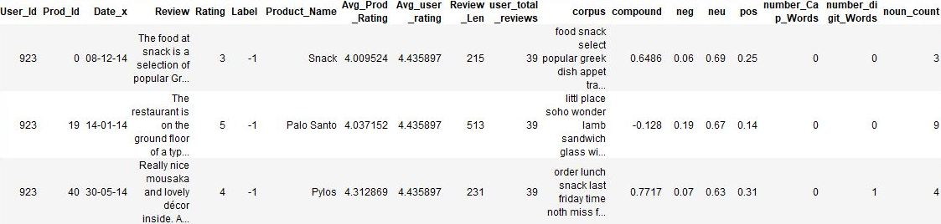
Dataset After Feature Extraction
Corpus - Review After text processing
Compound, neg, pos, neu - Sentiment score

Slide 12
What about unbalanced data ?
Techniques used :-
Random Oversampling
Increases minority classes through repetition of existing samples.
Synthetic Minority Over-sampling Technique
Creates new training sample from existing ones, adding variety.

Slide 13
Methods used for classification
Logistic regression
Estimates relationship between one dependent variable and one or more independent variables
Naive Bayes Classifier
Probabilistic machine learning model that’s used for classification task
Based on the Bayes theorem.
K-Nearest Neighbors
Non parametric approach to classification
Chosen k = n^{1/2} where n is the number of samples (number of rows)

Slide 14


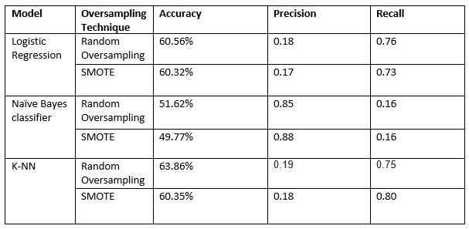
Results

Slide 15
References
Rayana, S. and Akoglu, L., 2015, August. Collective opinion spam detection: Bridging review networks and metadata. In Proceedings of the 21th acm sigkdd international conference on knowledge discovery and data mining (pp. 985-994). ACM.Citation Count: 120
Mukherjee, A., Venkataraman, V., Liu, B. and Glance, N., 2013, June. What yelp fake review filter might be doing?. In Seventh international AAAI conference on weblogs and social media. - Citation Count: 242
Wang, Z., Zhang, Y. and Qian, T., Fake Review Detection on Yelp.
Rout, J.K., Singh, S., Jena, S.K. and Bakshi, S., 2017. Deceptive review detection using labeled and unlabeled data. Multimedia Tools and Applications, 76(3), pp.3187-3211. Citation Count :15
Singh, M., Kumar, L. and Sinha, S., 2018. Model for detecting fake or spam reviews. In Ict based innovations (pp. 213-217). Springer, Singapore. Citation Count :3

